Slide 1

Movie Rental Data Analysis
Learner : Sakshi Laxman Waghmare
Guide : Shruti Gode

Slide 2
Business objectives
Movie on Rental Store, a chain operating in select countries, seeks to boost business by aligning its inventory with audience preferences. With an extensive collection of DVDs and Blue-ray discs, the management aims to enhance customer satisfaction, attract a wider audience, and improve overall business performance.
Determine the most frequently rented movie categories.
Recognize the actors in movies that are rented most frequently.
Identify the number of movies suitable for audiences under 17 years old.
1
2
3

Slide 3
TASK - 1
Display the full names of actors available in dataset.
We have used the concat function to merge the first name and last name columns from the same table, generating a new column that showcases the full names of actors in the dataset. The result contains 200 full names.
TASK – 2
Management wants to know if there are any names of actors appearing frequently.
Display the number of times each first name appears in dataset.
We have used the count aggregate function in SQL to show the frequency of each first name in the dataset, grouping the results by first names we have 128 records in result.
What is the count of actors that have unique first names in dataset? Display the first names of all these actors.
We have used the count function to identify unique first names in the dataset. After grouping the data by first names and applying a condition with the having clause, the result shows that there are 76 unique first names in the dataset.

Slide 4
TASK - 3
The management is interested to analyse the similarity in the last names of actors.
Display the number of times each last name appears in dataset.
We have used the count aggregate function in SQL to show the frequency of each last name in the dataset, grouping the results by last names we have 121 records in result.
Display the unique last names in dataset.
We have used the count function to identify unique last names in the dataset. After grouping the data by last names and applying a condition with the having clause, the result shows that there are 66 unique last names in the dataset.
TASK – 4
The management wants to analyse the movies based on their ratings to determine if they are suitable for kids or some parental assistance is required.
(The movies with R rating are not suitable for audience under 17 years of age)
Display the list of records for the movies with the rating “R”.
We have used a where clause to filter records with an "R" rating, indicating that there are 195 records unsuitable for audiences under 17 years old.

Slide 5
TASK – 4
Display the list of records for the movies that are not rated “R”.
We have used a where clause to filter records with a rating other than "R", resulting in 805 records.
Display the list of records for the movies that are suitable for audience below 13 years of age.
We have used a where clause to find movies with a "PG-13" rating in the dataset. There are 223 films suitable for audiences under 13 years old. (“PG-13” is the rating for those movies which are suitable for under 13 years of age audience).
TASK – 5
The board members want to understand the replacement cost of the movie copy(disc-DVD/Blue Ray). The replacement cost refers to the amount charge to customer if the movie disc is no returned or is returned in a damage state.
Display the list of records for the movies where the replacement cost is up to $11.
We have used where clause with a comparison operator to identify records with a replacement cost up to $11. There are 90 records meeting this criteria.
Display the list of records for the movies where replacement cost is between $11 and $20.
We have applied a where clause with the between operator to identify records where the replacement cost falls between $11 and $20. There are 424 records meeting this criteria.
Display the list of records for all the movies in descending order of there replacement cost.
We have used a where clause with an order by statement to show the list of records in descending order based on replacement cost.

Slide 6
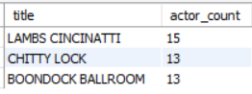
TASK – 6
Display the names of top 3 movies with greatest number of actors.
Interpretation:
To find movies with the highest number of actors, we have joined the tables film and film_actor to count the number of actors per movie. Then, to obtain the top 3, we ordered the data using the order by statement and selected the top 3 using the limit clause.

Slide 7
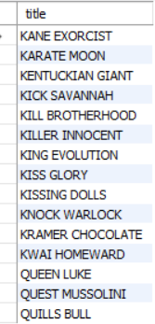
TASK – 7
"Music of Queen" and "Kris Kristofferson" have seen an unlikely resurgence. As an unintended consequence, films starting with the letters "K" and "Q" have also soared in popularity.
Display the titles of the movies starting with the letters "K" and "Q".
Interpretation:
We have used a where clause with the like operator to showcase movie titles starting with the letters "K" and "Q". The result includes 15 movie titles that meet this criteria

Slide 8
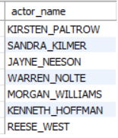
TASK – 8
The film “Agent Truman” has been great success display the name of all actors who appears in this movie.
Interpretation:
We have joined the actor, film_actor, and film tables to show the names of actors in the movie "Agent Truman." Using a where clause with a comparison operator, we filtered the data, revealing that there are 7 actors in the "Agent Truman" movie.

Slide 9
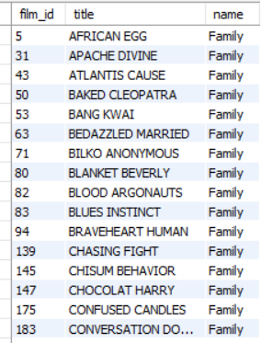
TASK – 9
Sales has been lagging among young families, so the management wants to promote family movies. Identify all the movies categorized as family films.
Interpretation:
We have joined the film, film_category, and category tables to extract movie names from the family category. By employing a where clause with a comparison operator, we identified 69 movies in the dataset that belong to the family category.

Slide 10
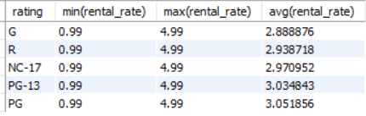
TASK – 10
The management wants to observe the rental and rental frequencies (Number of times the movie disc is rented)
Display the maximum, minimum and average rental rates of the movies based on their ratings the output must be sorted in descending order of the average rental rates.
Interpretation:
We have used the min, max, and avg aggregate functions to show the minimum, maximum, and average rental rates. The data was grouped by rating using the group by clause.
TASK – 10
Display the movies in descending order of their rental frequencies, so the management can maintain more copies of those movies.
To display movie in descending order of their rental frequencies. We have joined the film, inventory, and rental tables, grouped the data by movie name using group by clause, and arranged it in descending order based on rental frequency using the order by clause. “BUCKET BROTHERHOOD” is the maximum time rented movie from the dataset.

Slide 11
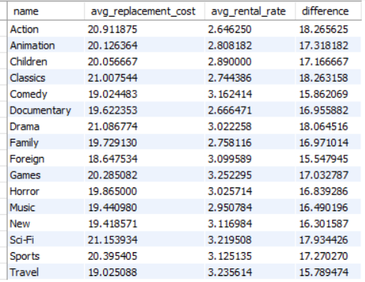
TASK – 11
In how many film categories, the difference between the average film replacement cost ((disc- DVD/Blue Ray) and the average film rental rate is greater than $15 ?
Display the list of all film categories identified above along with the corresponding average film replacement cost and average film rental rate.
Interpretation:
To show movie categories with a difference between the average replacement cost and average rental rate greater than $15, we joined the film, film_category, and category tables. We have grouped the data by category using the group by clause and applied the condition using the having clause

Slide 12
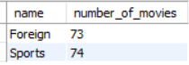
TASK – 12
Display the categories in which the number of movies greater than 70.
Interpretation:
To showcase the categories with the highest number of films, we have joined the category, film_category, and film tables. Using the count aggregate function, we obtained the film count for each category, grouped the data by categories using the group by clause, and applied the condition using the having clause.

Slide 13
interpretation
Popular horror, drama, sports, travel, and games movies are the categories from which movies frequently rented.
Most movies in the collection are from foreign origins, with a notable emphasis on sports genres.
The blockbuster movie "Agent Truman" featured popular actors Kirsten Paltrow, Sandra Kilmer, Jayne Neeson, Warren Nolte, Morgan Williams, Kenneth Hoffman, and Reese West
Movies like "Lambs Cincinnati," "Chitty Lock," and "Boondock Ballroom" stand out for having the maximum number of actors in their casts
There are 223 family-friendly movies suitable for audiences under 13.
Conversely, 195 movies are not recommended for viewers under 17, offering a diverse range of content for various age groups

Slide 14


